Slide 1
Building Intelligent Applications using Bot Framework
Speaker: Anusua Trivedi

Slide 2
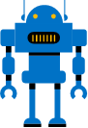
What is a bot?

Slide 3
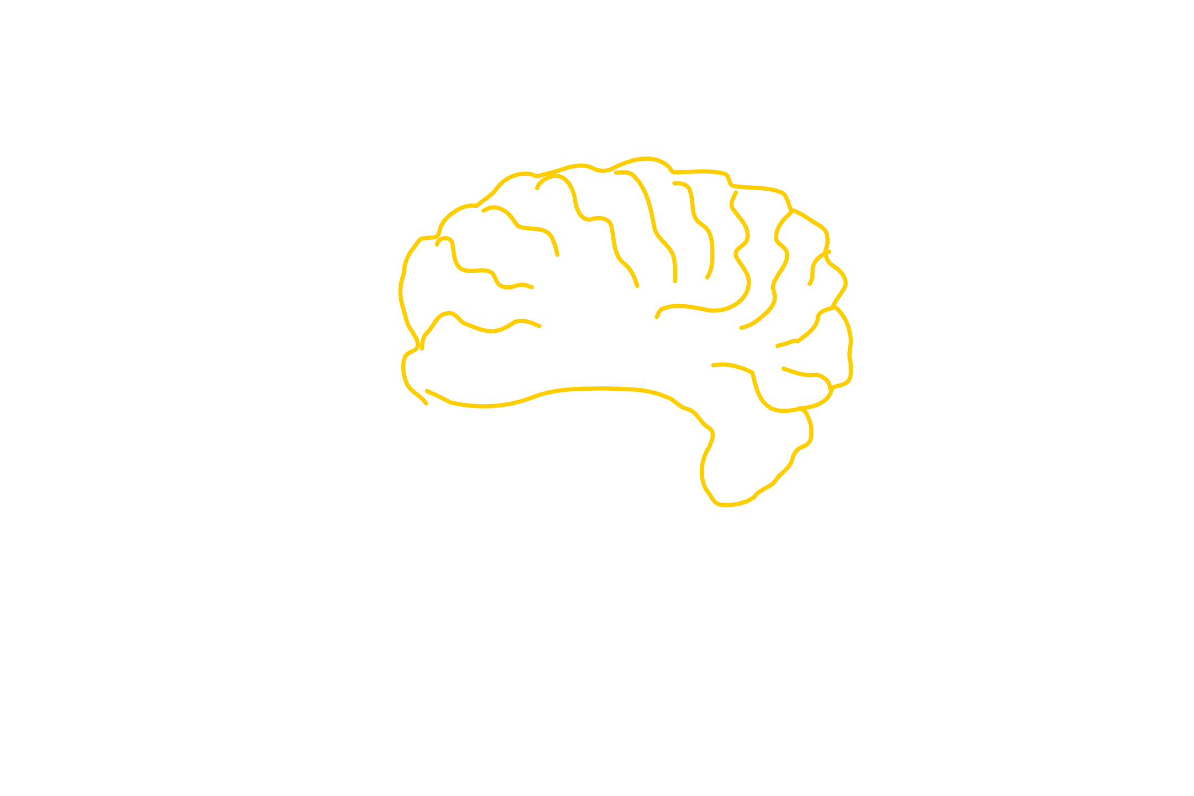
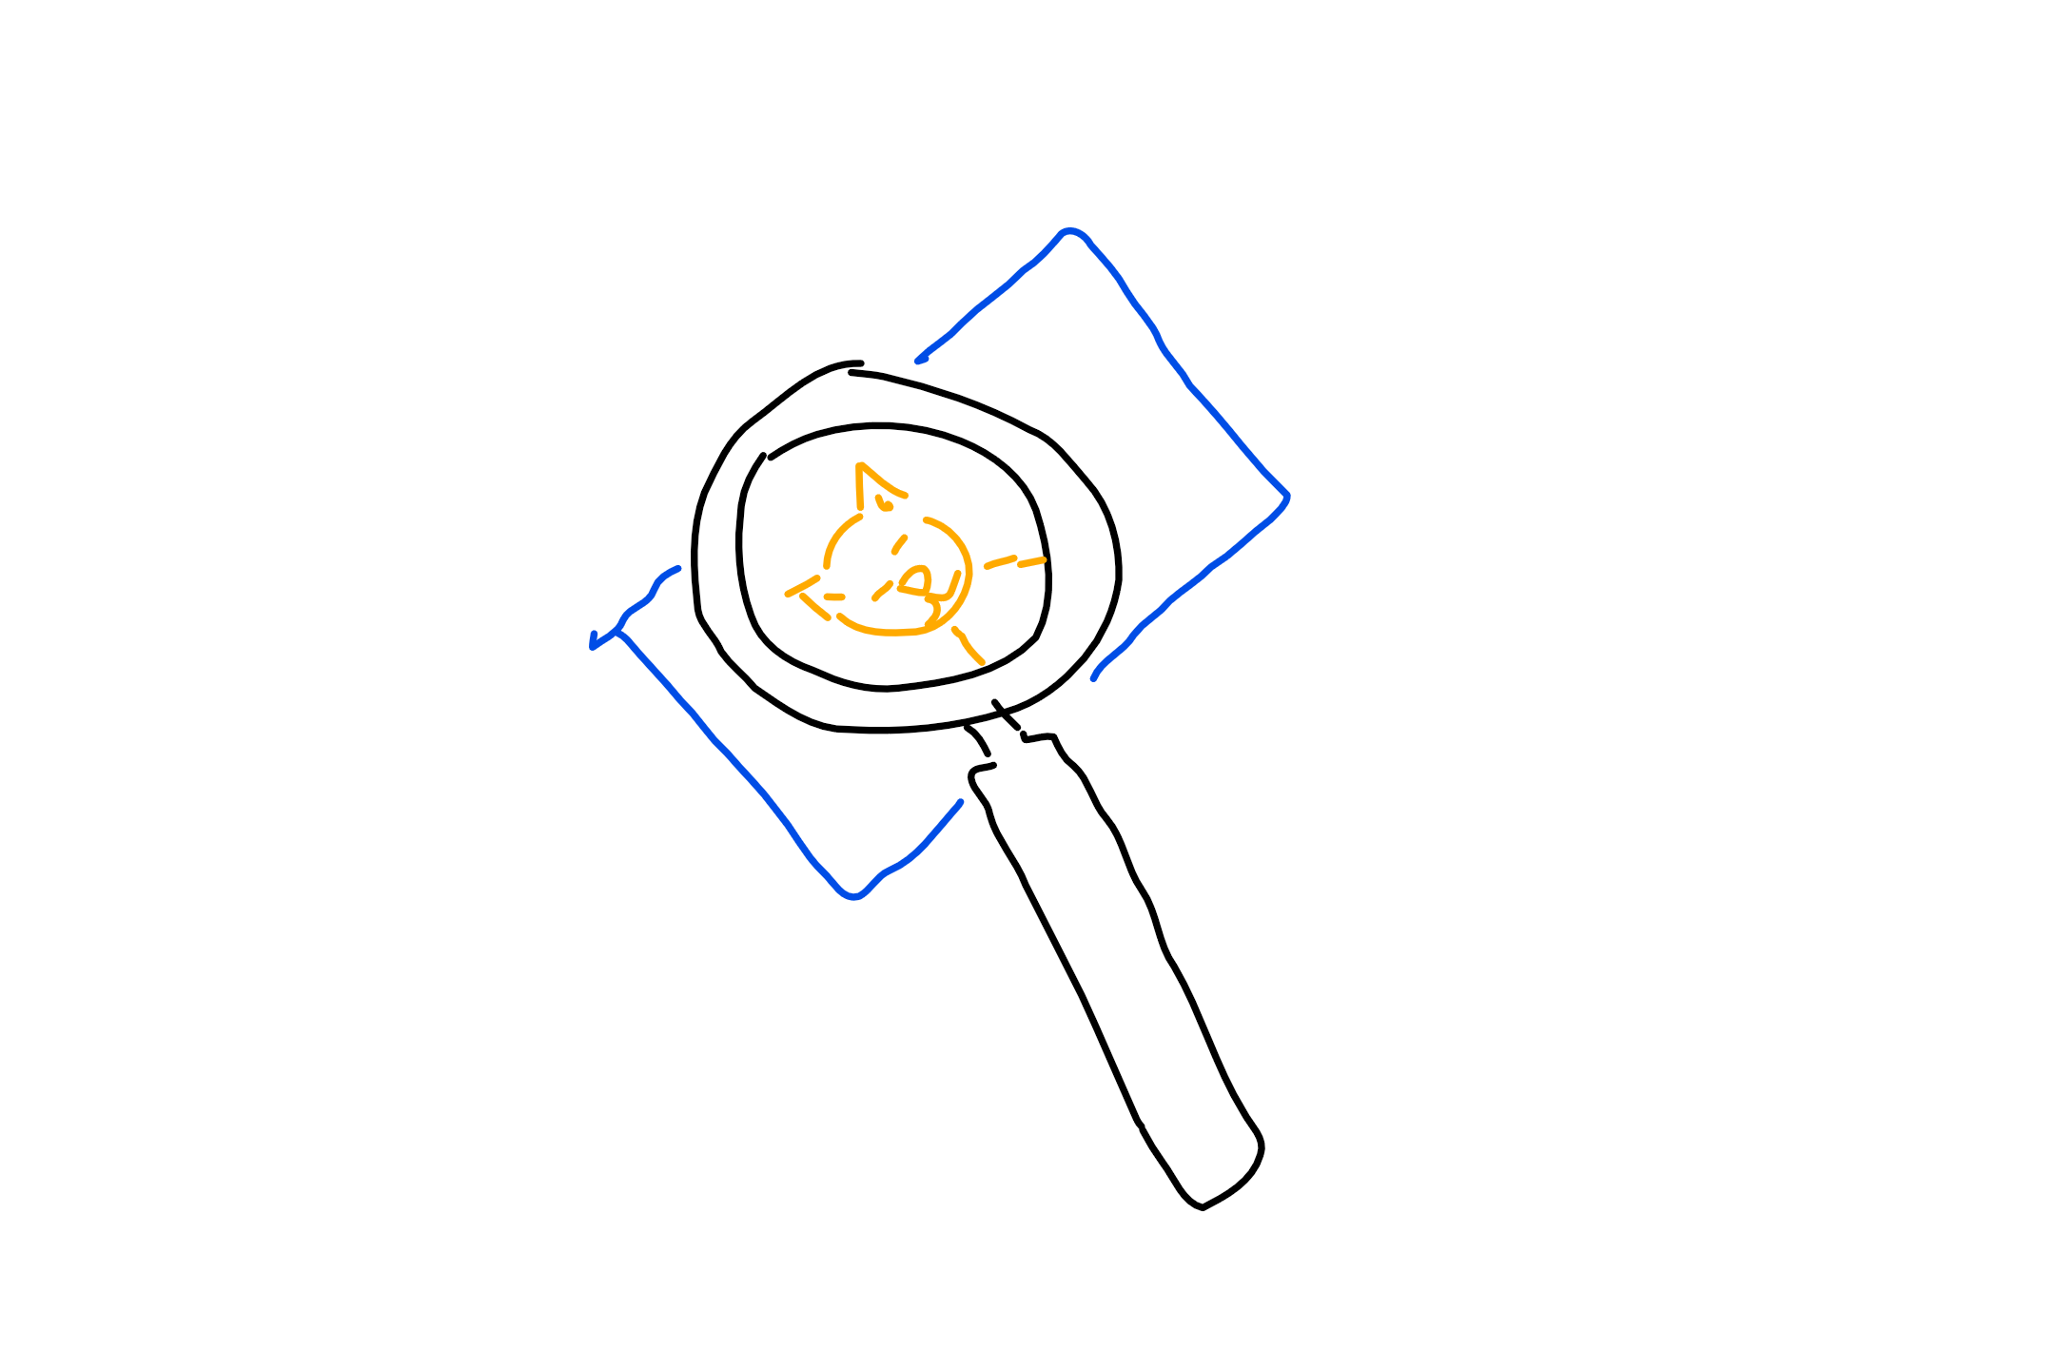
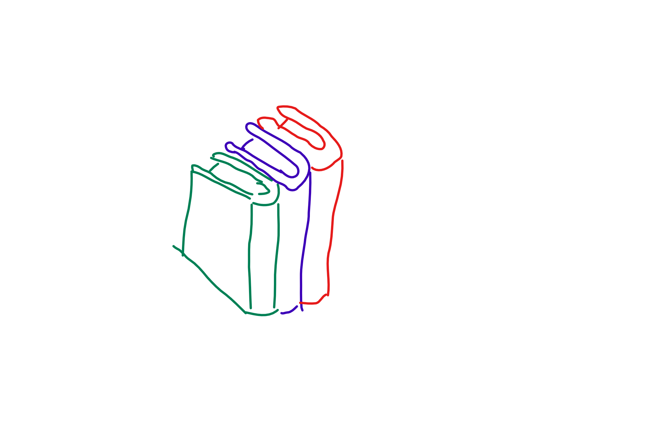
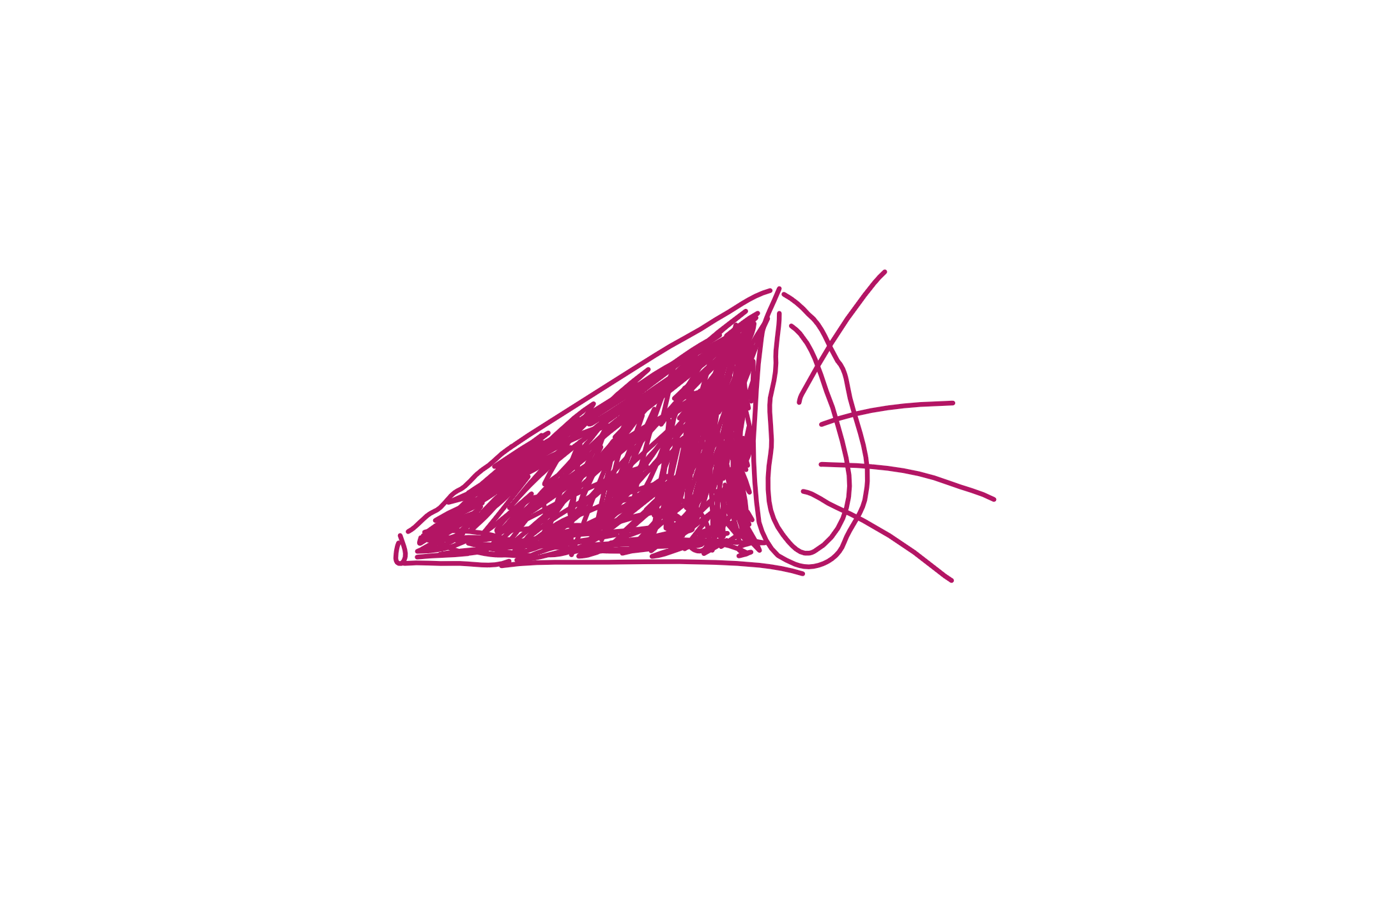
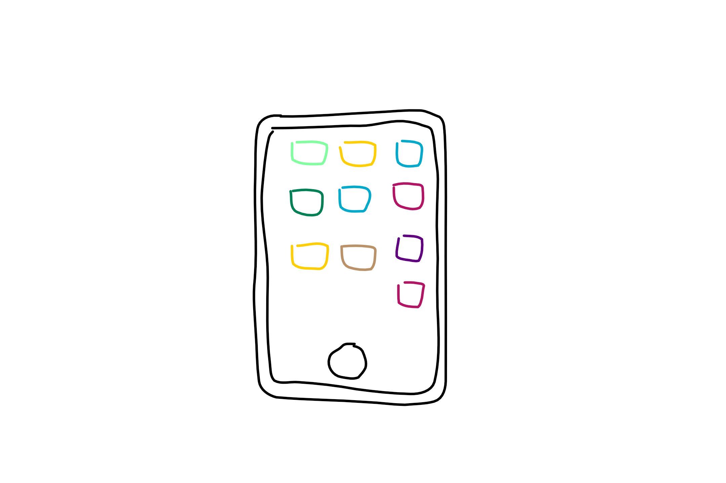
What a bot is not
It’s not AI
It’s not natural language processing only
It’s not text interfaces only
Notes:
Not AI:
Bots can be simple task automation utilities.
Example: Password reset bot. There’s no AI here. Just ask a couple of security validation questions, then reset the password.
They may have AI as well, if the scenario applies
Not only NLP:
Natural language processing has limitations, still. The more your bot depends on NLP, the worse the experience gets. Hint: Typing isn’t always the best option.
Move away from NLP as quickly as possible
“Drive” the user as much as you can (menus, choices, etc). Less typing = better
Not only text interfaces:
Bot channels are evolving quickly to support richer experiences: Media, buttons, custom controls. These are here or on their way. Text is not known to the best experience for everything.
Examples:
Skype allows audio and 3D bots as well.
Slack, Facebook and Skype have buttons/custom UIs

Slide 4
What is a bot?
Simply put, a bot is an application that performs an automated task. That’s it.
Notes:
Siri, Cortana, the old-school MS Clippy and even AOL’s SmarterChild are some examples. Essentially, bots perform automated tasks that are generally REPETITIVE for humans to do. We want to make life easier for the end user of the bot.
Bots are apps.
They can:
Exist in different channels and across platforms.
Do anything from simple task automation like taking food orders to leveraging sophisticated deep learning algos as is used by CaptionBot (https://www.captionbot.ai/ which describes the contents of an image how a human would) and otherAI-esque capabilities.
What a bot can do is only limited to the APIs your bot uses.
Bots don’t have to leverage the MS Bot Framework (e.g. MimikerAlarm https://www.microsoft.com/cognitive-services/en-us/mimickeralarm, an app for waking you up), but the Framework makes dev and deploy much simpler and faster for.

Slide 5
What types of bots are there?
Notifiers
Reactors
Responders
Conversationalist
Complexity
Notes:
Based on this blog post: http://willschenk.com/bot-design-patterns/?imm_mid=0e50a2&cmp=em-data-na-na-newsltr_20160622 about different bot types and the definitions of these.
Notifier - simply broadcast messages aka push bot e.g. ping me when there's a interesting tweet about Hadley Wickam
Reactor - reacts to messages on service, but doesn’t persist anything (message, user state, location) e.g. send me the stock price for a stock I specify, but don't remember me or what I say
Responder - reacts to messages on service, persists message and knows who I am e.g. send me today's weather forecast for a city, use my user name on this channel, and remember what cities I choose
Conversationalist – reacts to messages, persists messages, knows who I am, knows about the “place” I’m at (channel, room,…), knows the state of the conversation e.g. send me today's weather forecast for a city, use my user name on this channel, remember what cities I choose, format it nicely for this channel, and if the conversation is old, archive it and send as email.
From “Bot Design Patterns”: Questions that help us formulate what kind of bot we might want or need:
Do they react to messages?
Do they know who they are talking to?
Can they learn from what was said?
Do they know where the conversation is taking place?
Do they remember the overall conversation?

Slide 6
The bot life cycle
1. Tangible problem
5. Improve on current bot
2. Ask: How is bot better way
4. Collect bot metrics
3. Get around heavy use of NLP
Notes:
Start by asking what problem are we trying to solve. Refine until it looks like a tangible problem and not “magic”
Ask how a bot will be a better experience. User experience is EVERYTHING
Avoid too much natural language. Careful with unrealistic expectations. Natural language recognition is limited. Menus work great. Commands work great. Buttons, etc.
You can only analyze and improve your bot if you’re collecting metrics for it
Iterate, improve

Slide 7
Here enters the Bot Framework

Slide 8
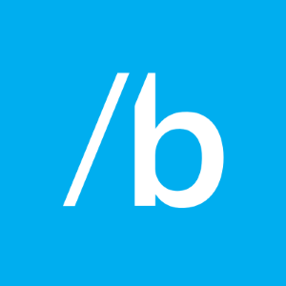


Bot Builder SDK
Bot Framework Developer Portal
Bot Directory
Dev
Connect
Publish
Notes:
Bot Builder is itself a framework for building conversational applications (“Bots”).
The Bot Builder SDK is an open source SDK hosted on GitHub that provides everything you need to build great dialogs within your Node.js-, .NET- or REST API-based bot.
The Bot Framework Developer Portal lets you connect your bot(s) seamlessly text/sms to Skype, Slack, Facebook Messenger, Kik, Office 365 mail and other popular services. Register, configure and publish.
The Bot Directory is a public directory of all reviewed bots registered through the Developer Portal.
NB: Bot builder and bot connector SDK now one in V3 of framework: http://docs.botframework.com/en-us/support/upgrade-to-v3/#botbuilder-and-connector-are-now-one-sdk

Slide 9
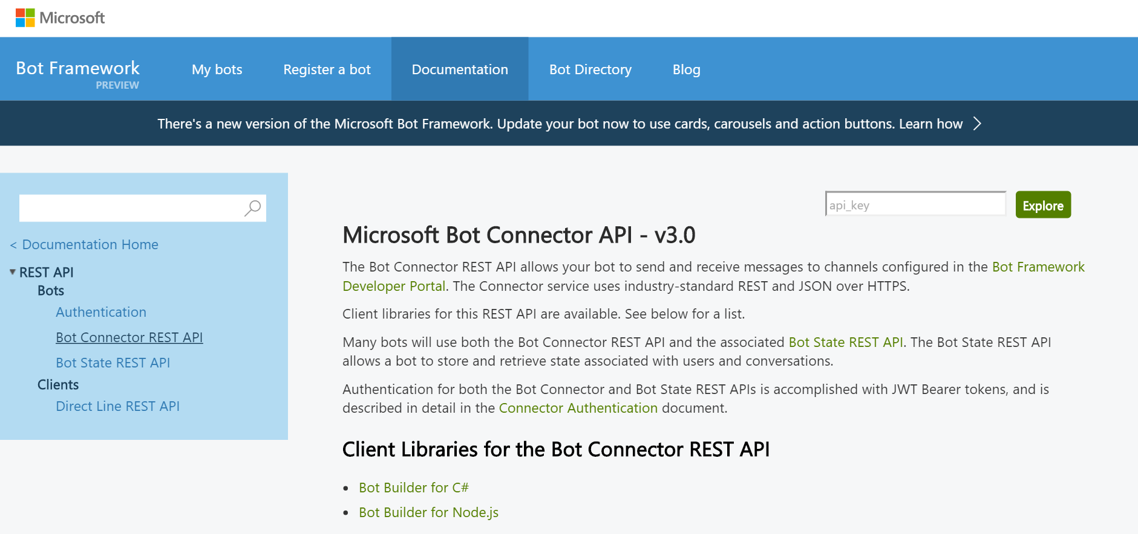
Bot Builder: Development Kits and REST
Bot Builder SDKs for:
.NET framework for C#
Node.js
And there’s also
REST and REST State APIs
Notes:
SDKs infographic: http://docs.botframework.com/en-us/images/faq-overview/bot_builder_sdk_july.png

Slide 10
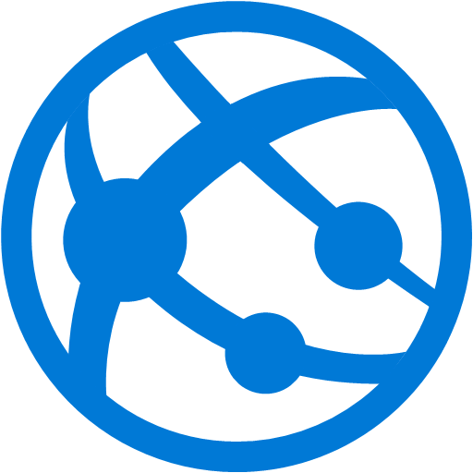
Developer Portal: what registration does for you
Your bot’s web service in the cloud
MS Bot Framework Connector
Notes:
Expose a Microsoft Bot Framework-compatible API on the Internet, then the Bot Framework Connector service will forward messages from your Bot to a user, and will send user messages back to your Bot.

Slide 11
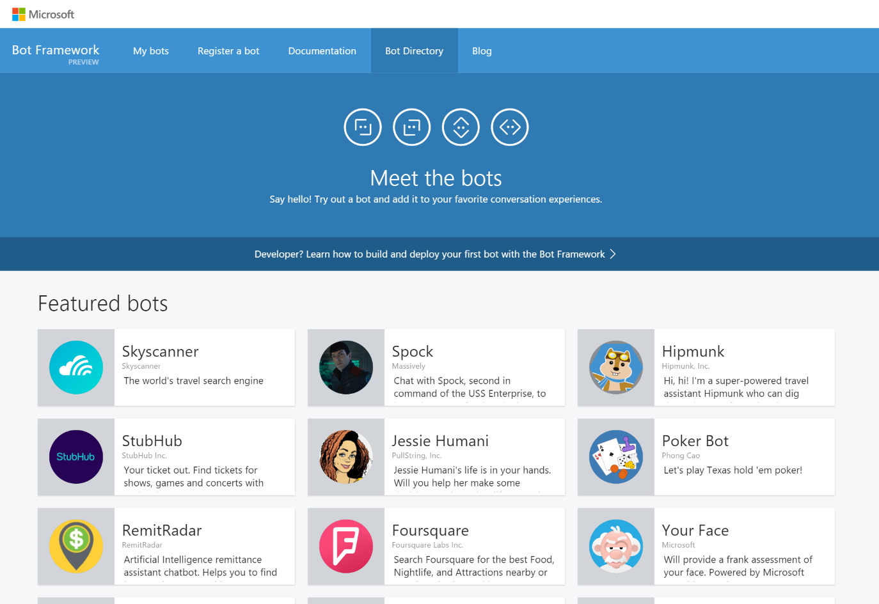
Bot Directory
Public Directory of Bot Framework Bots
Discover, try, and add bots from here with no added configuration
Bots are public at developer discretion; must be reviewed
Searchable here
Notes:
Bots must be submitted for review and approved in order to appear in the directory
As of Nov. 17, 2016 there are 94 bots in the directory from MS and other companies

Slide 12
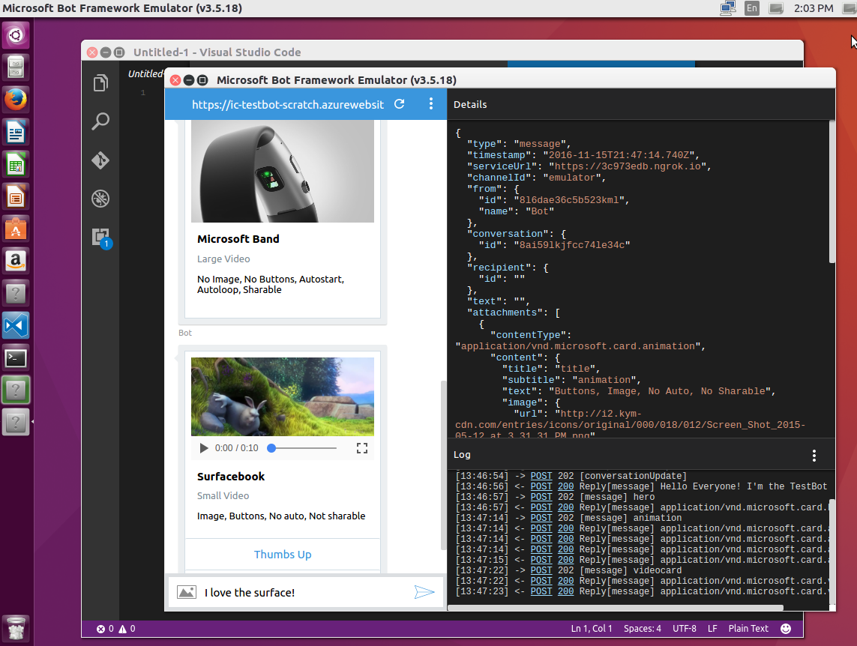
The BF Emulator to test a Bot
New Support for Mac, Linux and Windows
New All the Bot Framework card types are supported
New Save multiple profiles for when you’re working online and off
New Simplifies configuration when you’re working with ngrok
New Uses the webchat control for higher fidelity layout and consistency with the webchat experience
Notes:
Emulator purpose:
Send requests and receive responses to/from your bot endpoint on localhost
Inspect the Json response
Emulate a specific user and/or conversation

Slide 13
Working with channels

Slide 14
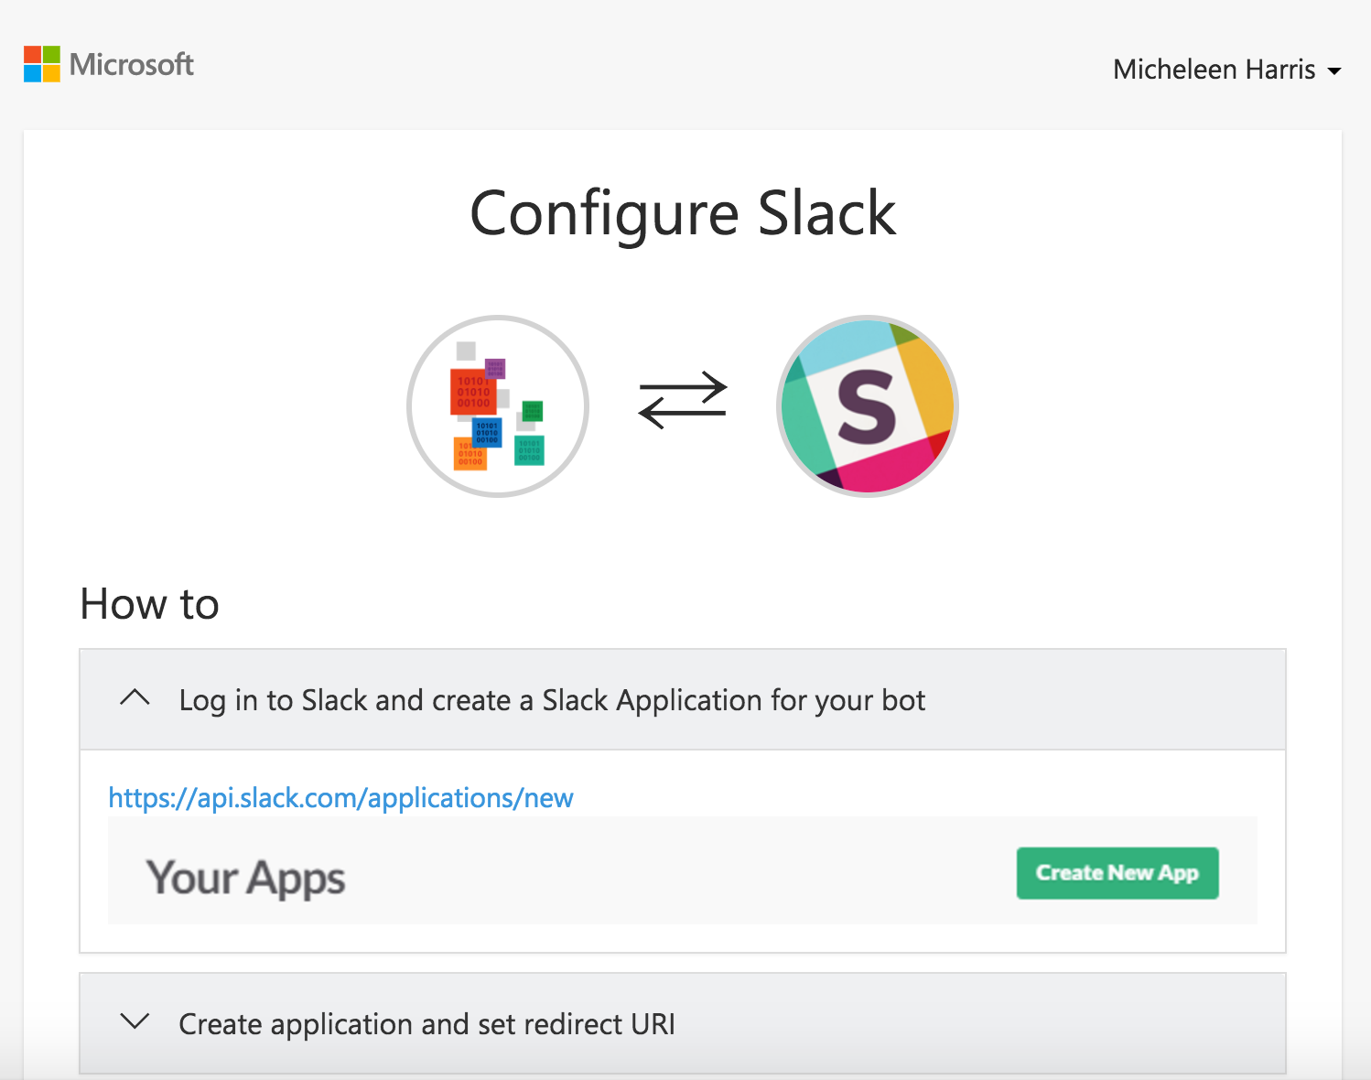
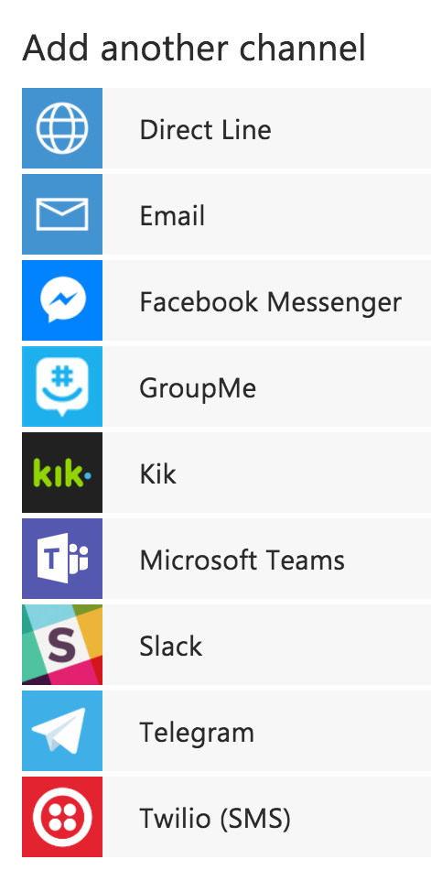
Adding a channel
Skype is added by default
Instructions are laid out
Notes:
Often, the most time will be spent configuring your credentials as a developer on the target service, registering your app, and getting a set of Oauth keys that Microsoft Bot Framework can use on your behalf

Slide 15
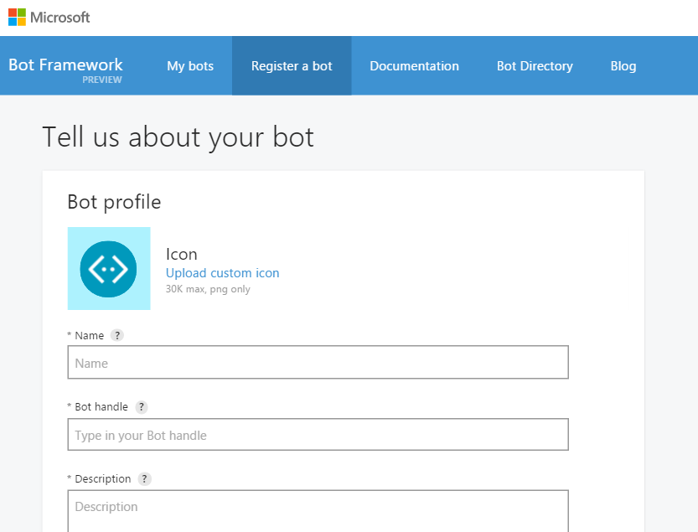
Register a Bot in the Developer’s Portal
Notes:
Register on the developer portal by clicking the ‘Register a bot’ link: https://dev.botframework.com/bots/new
Name: TemplateBot
Bot Handle: templatebot (for referencing in Bot Directory and name for bot on web chat, NOT the app’s URL used as endpoint)
Also, add a description here
Configuration
Remember the URL endpoint from deploying endpoint step. Should be something like: “https://botwebappname.azurewebsites.net/api/messages”
You’ll go through the “Generate App ID and password” wizard, then return to the registration page.
Go back and edit this profile anytime

Slide 16
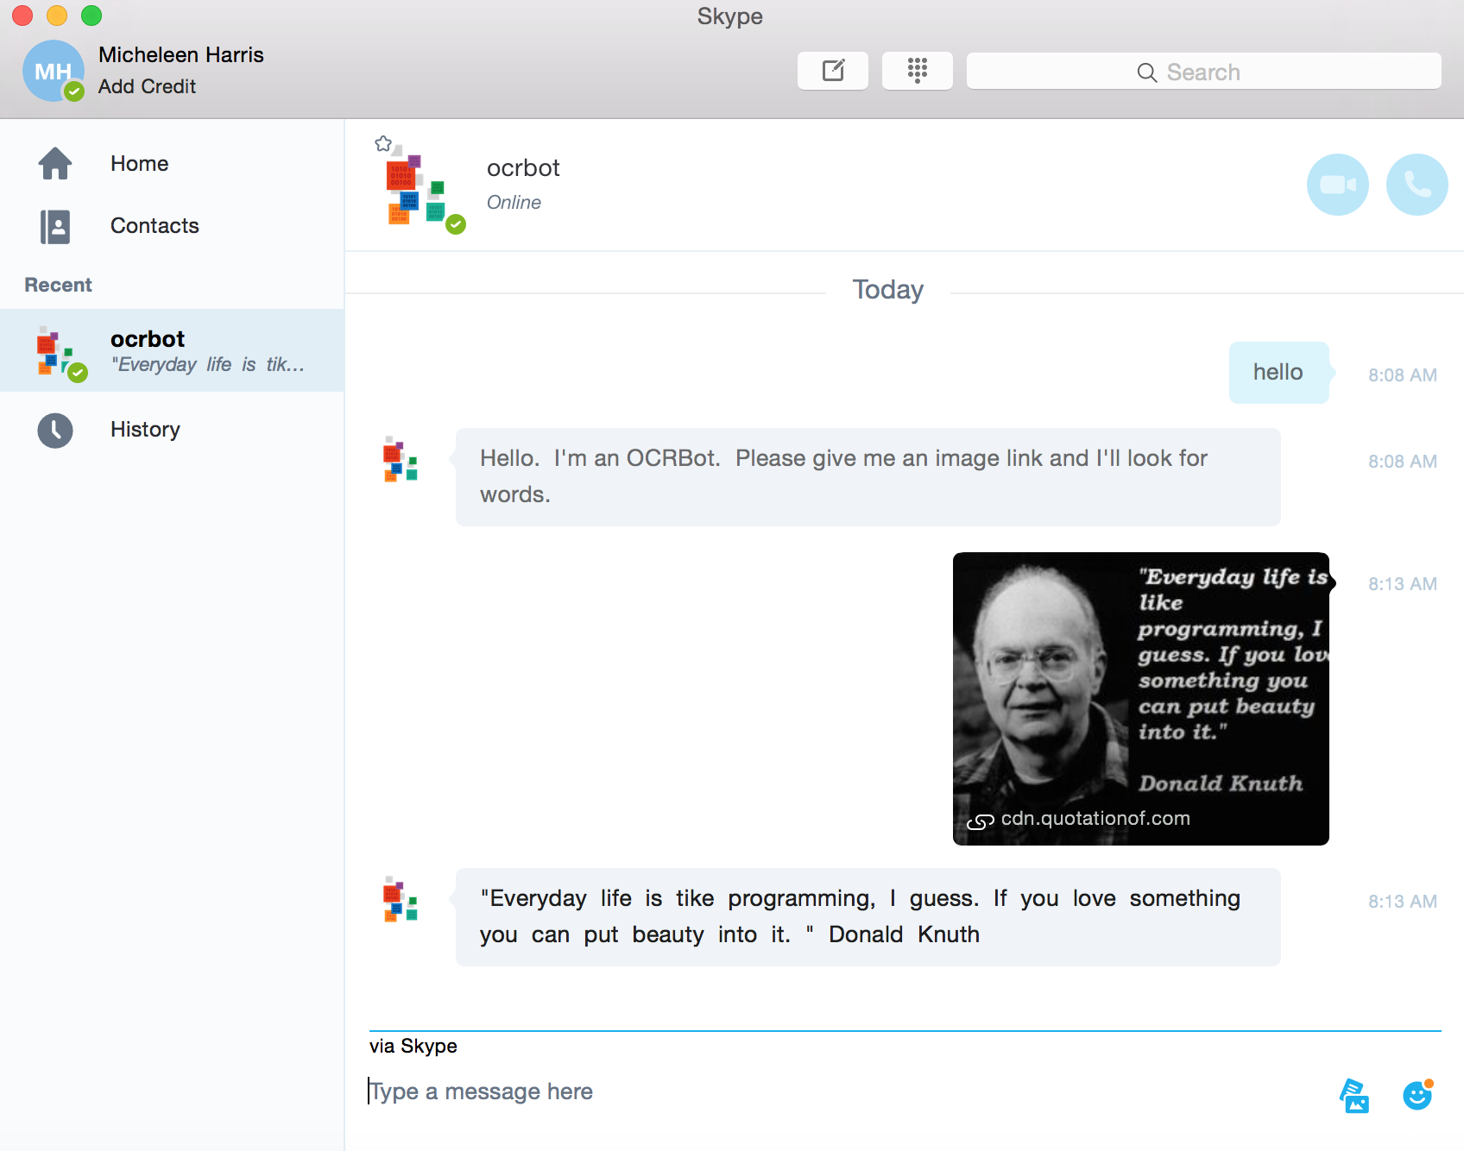
Skype channel example

Slide 17
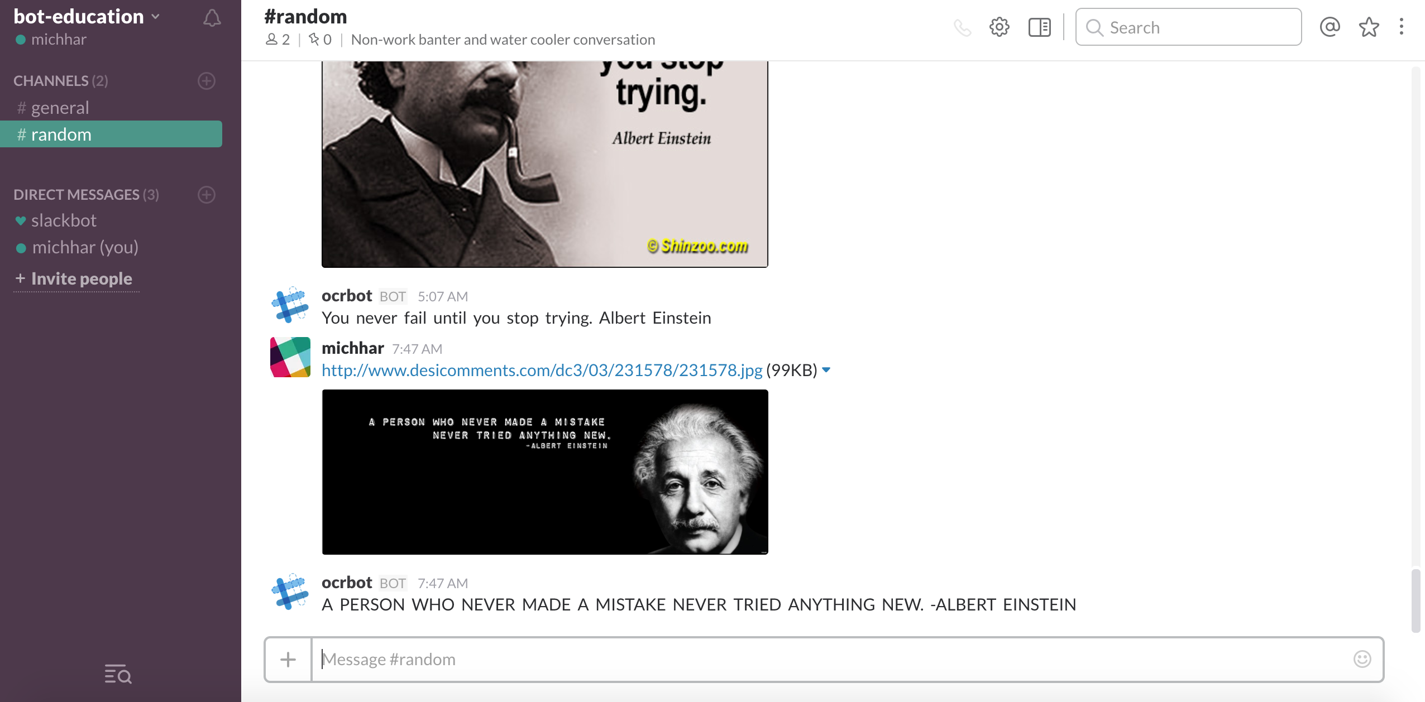
Slack channel example

Slide 18

How to make BOTs smarter?
Notes:
Ethical and societal considerations taken directly from an article by Satya Nadella: https://www.linkedin.com/pulse/partnership-future-how-humans-ai-can-work-together-solve-nadella

